Slide 1

Azure Synapse Link for Azure Cosmos DB
L200 deck

Slide 2
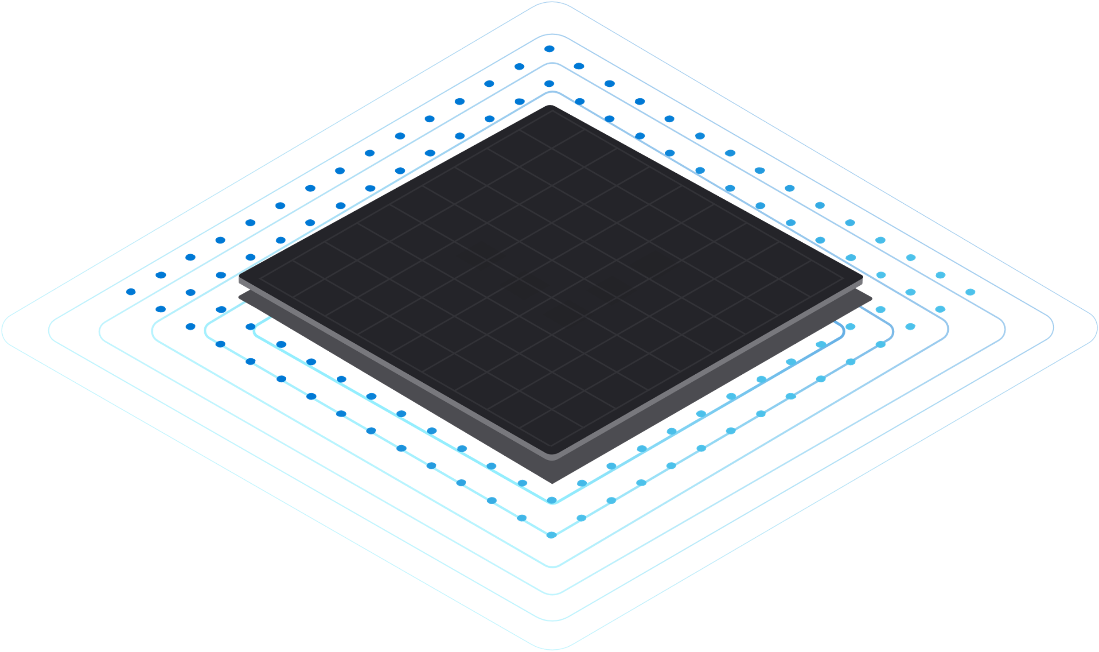


Azure Synapse Link for Azure Cosmos DB
HTAP = Breaking down the barrier between OLTP & OLAP
Near real-time data analytics
No performance impact on transactional workloads
Costs reduction for BI and Analytics workloads
Simplified management
1
Azure Synapse
Azure
Cosmos DB

Slide 3






Azure Cosmos DB Analytics Before Synapse Link
Run OLTP & OLAP workloads on the same database
Separating OLTP & OLAP
Azure Synapse Analytics
Azure Cosmos DB
Real-time Applications & Services
User Applications
Azure Cosmos DB
Data Lake
Synapse SQL
Power BI
Reporting & Dashboards
Orchestrate
Performance impact on both workloads at scale
Data archiving is delayed to meet analytics demands
Costs and latency increase as the data volume grows
Ingest data periodically from Azure Cosmos DB to Data Lake
Delayed insights and reports
Management complexity: data formats, ETL jobs, and storage

Slide 4
Azure Cosmos DB Analytics Before Synapse Link
Change Feed and materialized views would also be used for reporting. But..
Customers still have to deal with a partition key
Customers still have to use RUs and transactional store
Different aggregations demand new Azure Functions programing
Azure Functions is billed by execution, possible cost issue for big data volume
Doesn’t address analytics: full scans, joins, complex queries, etc
1
Azure Synapse
Azure
Cosmos DB

Slide 5




Azure Synapse Link for Cosmos DB
Transactional Store
Row store optimized for transactional operations
Analytical Store
Column store optimized for analytical queries
Container
Machine learning
Operational
Data
Cloud-Native HTAP
Big data analytics
Auto-Sync
Azure Synapse Link
SQL
serverless
BI Dashboards
Azure Cosmos DB
Azure Synapse Analytics
Generate near real-time insights on your operational data

Slide 6

Analyze your data with Synapse Apache Spark
Ad-hoc data exploration
Find answer to unknown questions
Create Spark Tables for frequent access for Interactive Spark SQL
Use DataFrames to read Cosmos DB data for Batch or Stream Processing and Machine Learning
Write into a new or existing Cosmos DB container (through the OLTP store)
Simple to use and secure thanks to its integration with linked service connection
Big data analytics
Data Preparation/Curation
Machine learning
Build and deploy models
Azure Machine Learning

Slide 7


Query your data with Synapse SQL serverless
Create Views for frequent access for Interactive SQL
Run analytical T-SQL queries: Query Azure Cosmos DB data in place, in seconds
Build rich near real-time dashboards: Using Power BI integrated in
Use wider range of BI and ad-hoc querying|
Integrated using T-SQL interface
Build a logical data warehouse :
Analyze unified view of data across Azure Cosmos DB,
Azure Data Lake Storage & Azure Blob Storage
Power BI
Openrowset
Openrowset
Container
Auto-Sync
Available in public preview since October 2020

Slide 8















Analytics + BI patterns with Azure Synapse Link
Azure Data Lake Store gen2
Other data sources
Azure Cosmos DB
Azure Synapse Link
Synapse SQL
serverless
Synapse
SQL pool
Azure Machine Learning
Azure Synapse Analytics
Power BI
BI Dashboards
Find answers to known questions
Ad-hoc data exploration
Find answer to unknown questions
Big data analytics
Data Preparation/Curation
Machine learning
Build and deploy models
Data warehousing
Enterprise data warehousing

Slide 9
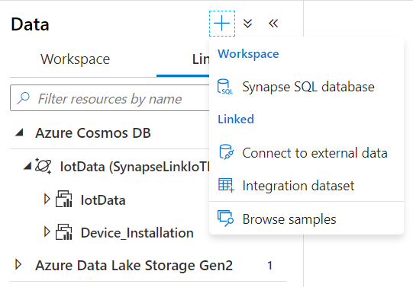
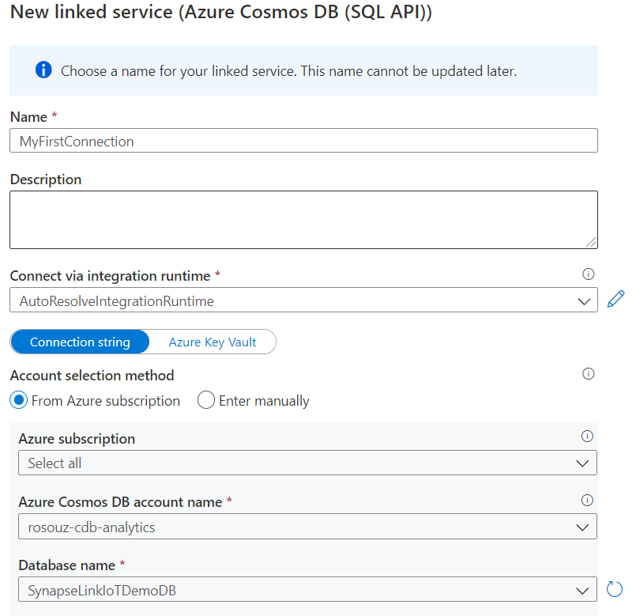
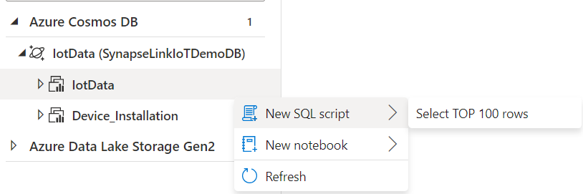
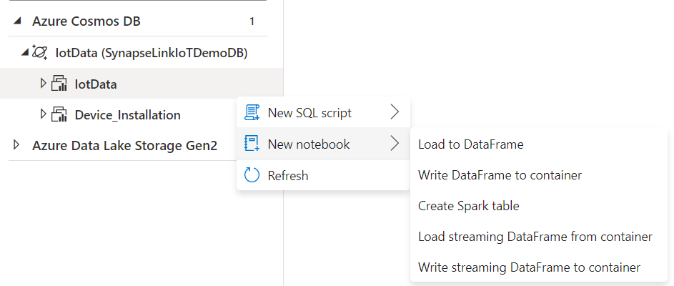
Azure Synapse Link :
Connect and Query in 3 Steps!
Step 1: Connect
Step 2: Select the Database
Step 3: Run a Spark or SQL command

Slide 10


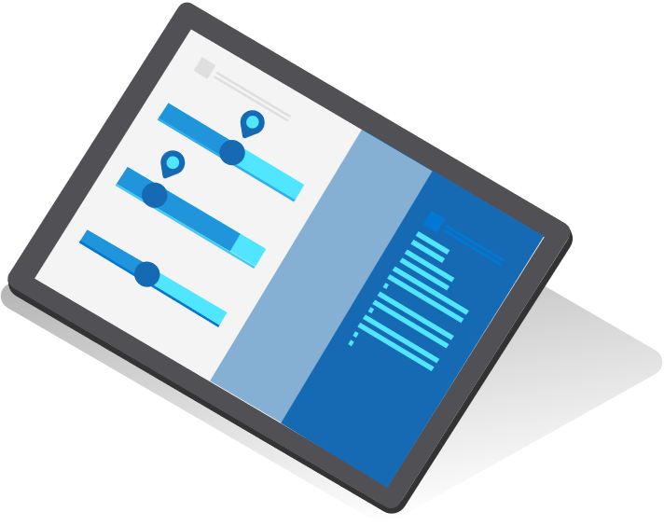

Typical Scenarios

Slide 11









Supply chain analytics, forecasting & reporting
Operational reporting
Azure Cosmos DB
Online Shoppers
Online Store Experience
Power BI
Store Management
Batch Data Integration
</>
</>
Azure Synapse SQL Serverless
</>
Inbound batch files
Azure Data Factory
{ }
{ }
Azure Streaming Analytics
Azure Synapse Spark
Azure Machine Learning
Logistics Telemetry
Streaming Data Integration
Prep & Train Prediction Pipeline
Notes:
Usually for Supply chain scenarios we will see both batch and on-line real time data. A typical architecture will load them all into cosmos db transactions

Slide 12


Real-time personalization
Online recommendation service
Azure Cosmos DB
Azure Active Director B2C
Azure Kubernetes Service (Recommendations API)
Shoppers
Web App (E-commerce store)
Azure Synapse (Spark processing pipeline)
Online order processing service
{ }
{ }
Azure Kubernetes Service (Recommendations API)
Transactional
Analytical

Slide 13





IOT predictive maintenance
Edge
Azure
Azure API Apps Real-time apps preforming data lookups and queries over hot data TTL = 90 days
IoT Devices
Azure IoT Edge Runtime
Azure IoT Hub
Azure Stream Analtics
Azure Cosmos DB (HTAP enabled)
Machine Learning Model
Power BI BI dashboards over historical data TTL = 3 years
Azure Cosmos DB (SQL Serverless)
SQL
Azure Synapse Analytics (Spark)
Azure Machine Learning
Machine Learning Model

Slide 14
Synapse Link for Cosmos DB Roadmap in 2022
AAD support
Existing containers for MongoDB API
Compatibility with continuous backup
Gremlin API

Slide 15
Official Labs
https://aka.ms/cosmosdb-synapselink-samples
IoT
Created dataset
SQL API
Streaming and Batch Ingestion into OLTP with Spark
Spark SQL joins
Anomaly Detection using MML Spark
Retail
Created dataset
SQL API
Batch Ingestion with Spark
Forecasting using Spark and AML SDK (AutoML)
E-Commerce (Food orders)
Data Generator
MongoDB API
Aggregations with Spark and Spark SQL

